Slide 1
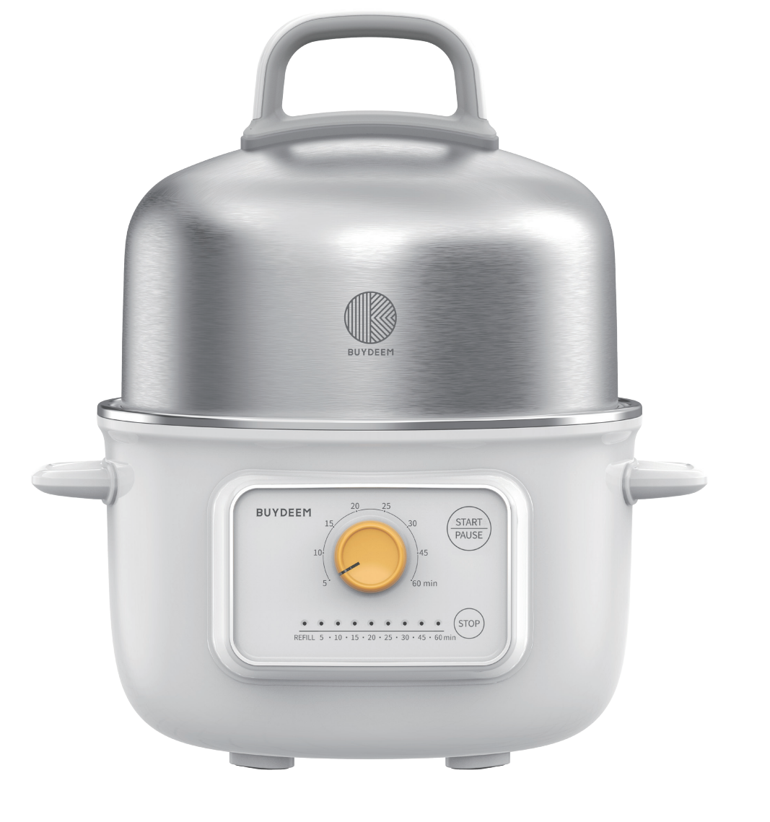
G32US Food Steamer Packaging Design
Digital Steamer

Slide 2
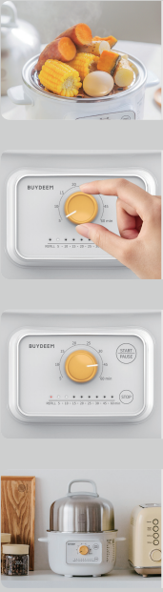
Enormous Capacity
An expanded lid offers more space to steam and prepare delicious and healthy food.
Convenient Countdown Timer
Simply select your cooking time and relax until your food is ready to eat.
Worry-free Cooking
Get a warning when water gets low or empty to ensure complete safety.
Compact Design
Vertical design takes up minimal space in your kitchen and sleek design compliments other kitchenware.

Slide 3
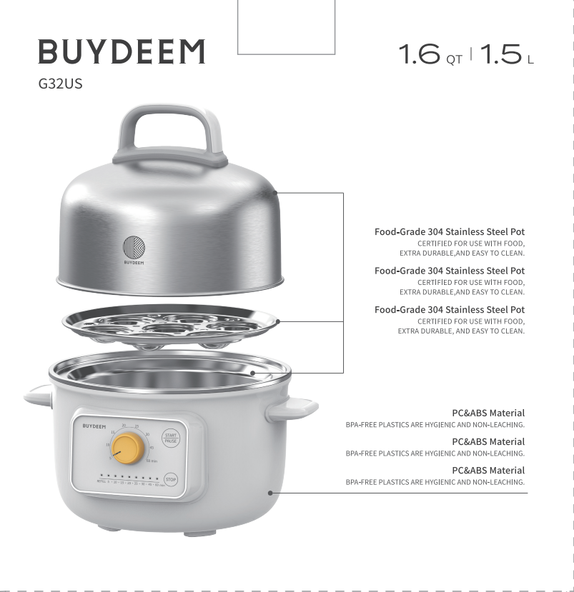
Food-Grade 304 Stainless Steel
Certified for use with food while boasting extra durability and easy cleaning.
PC and ABS Materials
BPA-free plastics are hygienic and non-leaching for healthy cooking for years to come.

Slide 4
Product Introduction
Here is a brief introduction of G 32US, hope it will help you understand this product.
Reasons of why Buydeem develop G32US
Steaming is the core requirement for users to use electric steamers.
Buydeem wants to use more reasonable configuration, lower price to meet the needs of more users.
Users want the product to be easier to use.

Slide 5
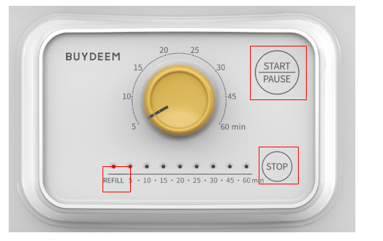
How to use G32US
Overall, G32US is a very simple product, and very easy to use
With 1 Knob and 2 buttons；
Short press [Star/Pause] to Start/pause cooking, long press [Start/pause] to stop working.
Press [Stop] to stop and power off
Rotate the button to adjust the cooking time
A light strip shows a countdown of cooking progress

Slide 6
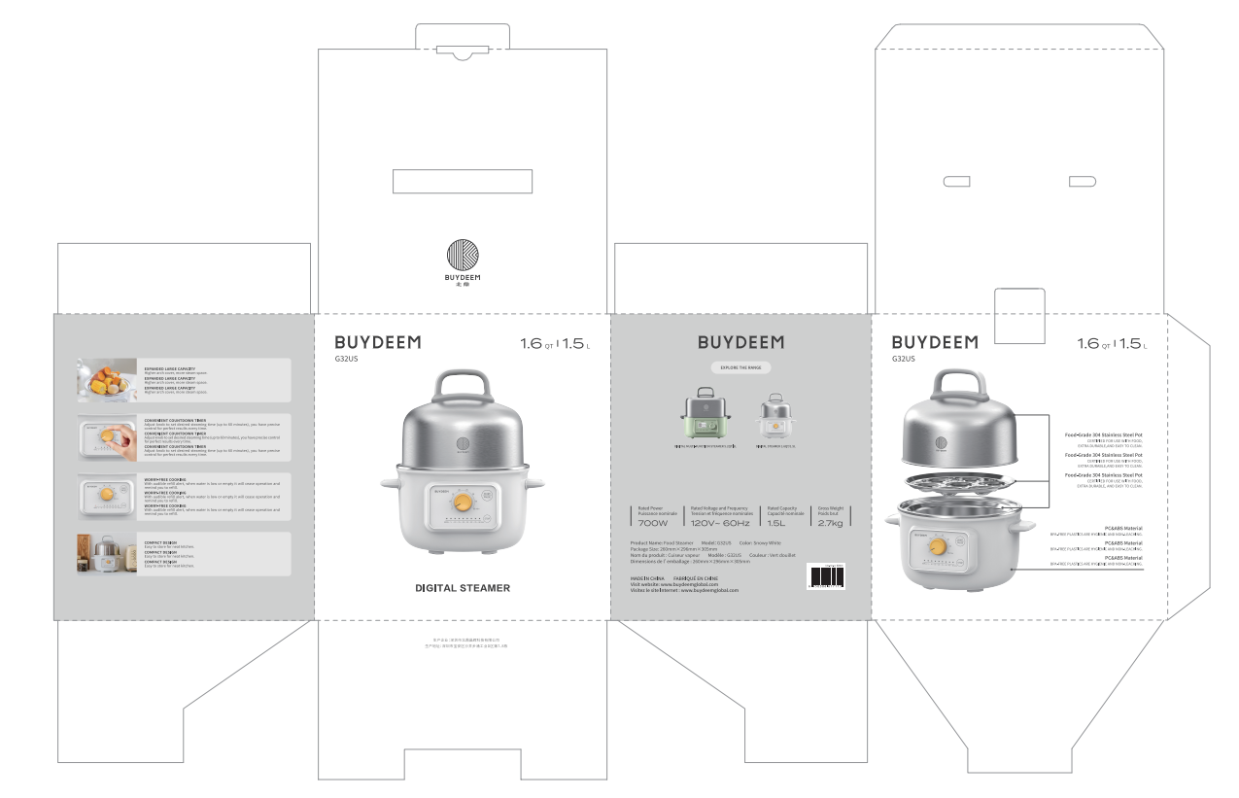
Cutting-die Design of G32US

Slide 7
